Slide 1
GH-100: GitHub Fundamentals - Administration basics and product features Part 1
GitHub Fundamentals - Administration basics and product features
- Part 1

Slide 2
Module 2: Introduction to GitHub Administration
Module 2: Introduction to GitHub Administration

Slide 3
Introduction
In this module, you will learn to evaluate GitHub’s access controls, design an adoption plan that aligns every team with the right repositories, and implement a scalable permissions model that safeguards your organization’s code and content while empowering developers and content creators.
By the end of this unit, you'll be able to:
GitHub administrative tasks and their purpose at each hierarchical level.
The various ways that administrators can configure authentication so that users can access GitHub via the web browser and the git client.
Hierarchical permission levels and what these permissions allow you to do in GitHub.

Slide 4

What is GitHub administration?
As a GitHub administrator, your goal is to keep everything working smoothly for your users. In this unit, you learn about the different levels in the GitHub organizational hierarchy and the administration tasks associated with each level.
Administration at team level
In GitHub, each user is an organization member that you can add to a team. You can create teams in your organization with cascading access permissions and mentions reflecting your company or group's structure. A team is a useful substructure for refining repository permissions on a more granular level and enabling communication and notification between team members.
Additionally, GitHub allows you to sync your teams with identity provider (IdP) groups such as Microsoft Entra ID. When you synchronize a GitHub team with Microsoft Entra ID, you can replicate changes to GitHub automatically. This sync reduces the need for manual updates and custom scripts. You can use Microsoft Entra ID with team synchronization to manage administrative tasks such as onboarding new members, granting new permissions, and removing member access to the organization.
Members of a team with team maintainer or repository admin permissions can:
Create a new team and select or change the parent team.
Delete or rename a team.
Add or remove organization members from a team, or synchronize a GitHub team's membership with an IdP group.
Add or remove outside collaborators (people who aren't explicitly members of your organization, such as consultants or temporary employees) from team repositories.
Enable or disable team discussions on the team's page.
Change the visibility of the team within the organization.
Manage automatic code review assignment for pull requests, utilizing GitHub's review assignment routing algorithm.
Schedule reminders.
Set the team profile picture.

Slide 5

Best Practices for team-level administration
Creating teams in your organization enables greater flexibility for collaboration and can make it easier to separate repositories and permissions. The following are some best practices for setting up teams on GitHub:
 | Create nested teams to reflect your group or company's hierarchy within your GitHub organization.
 | Help streamline PR review processes by creating teams based on interests or specific technology (JavaScript, data science, etc.). Individuals can choose to join these teams according to their interests or skills.
 | Enable team synchronization between your IdP and GitHub to allow organization owners and team maintainers to connect teams in your organization with IdP groups. When you synchronize a GitHub team with an IdP group, you can replicate changes to GitHub automatically, reducing the need for manual updates and custom scripts. You can use an IdP with team synchronization to manage administrative tasks such as onboarding new members, granting new permissions, and removing member access to the organization.

Slide 6

What is GitHub administration? (continued)
In GitHub, organizations are shared spaces enabling users to collaborate across many projects at once. Owners and administrators can manage member access to the organization's data and repositories with sophisticated security and administrative features.
Administration at organization level
Members of an organization with the owner permission can perform a wide range of activities at the organization level including:
Invite users to join the organization, and remove members from the organization.
Organize users into a team, and grant team maintainer permissions to organization members.
Add/remove outside collaborators (people who aren't explicitly members of your organization, such as consultants or temporary employees) to organizational repositories.
Grant repository permission levels to members, and set the base (default) permission level for a given repository.
Set up organization security.
Set up billing or assign a billing manager for the organization.
Extract various types of information about repositories via the use of custom scripts.
Apply organization-wide changes such as migrations via the use of custom scripts.
We recommend setting up only one organization for your users and repositories. If specific constraints in your company require you to create multiple organizations, you should be aware of the following points:
Duplicating an organization or sharing configurations between two organizations isn't possible. This means that you must set up everything from scratch every time you create an organization, which increases the risk of errors in your settings.
Depending on your software providers' policies, you might incur extra costs if you need to install some applications in multiple organizations.
Managing multiple organizations is more difficult!

Slide 7
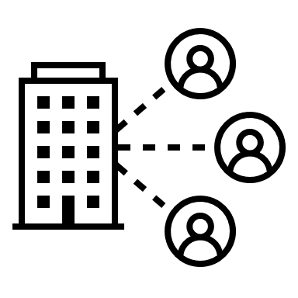
What is GitHub administration? (continued)
Enterprise accounts include GitHub Enterprise Cloud and Enterprise Server instances and enable owners to centrally manage policy and billing for multiple organizations.
Administration at enterprise level
At the enterprise level, members of an enterprise with the owner permissions can:
Enable security assertion markup language (SAML) single sign-on for their enterprise account, allowing each enterprise member to link their external identity on your IdP to their existing GitHub account.
Add or remove organizations from the enterprise.
Set up billing or assign a billing manager for all organizations in the enterprise.
Set up repository management policies, project board policies, team policies, and other security settings that apply to all the organizations, repositories, and members in the enterprise.
Extract various types of information about organizations via the use of custom scripts.
Apply enterprise-wide changes such as migrations via the use of custom scripts.

Slide 8
How does GitHub authentication work?
In the previous unit, you learned about typical administration tasks at the team, organization, and enterprise level. In this unit, you'll deep dive into one of the most common administrative tasks performed by organization owners, which is setting up and controlling users' authentication to GitHub.

Slide 9


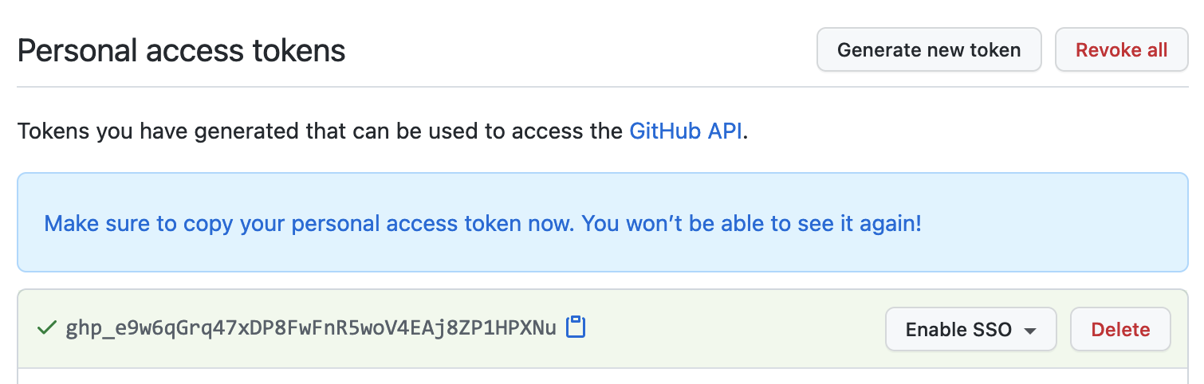
GitHub's authentication options
There are several options for authenticating with GitHub:
Username and password
Personal access tokens
Administrators can allow users to continue using the default username and password authentication method, sometimes known as the "basic" HTTP authentication scheme. In recent years, basic authentication has proven to be too risky when dealing with highly sensitive information. We strongly recommend using one (or several) of the other options listed in this unit.
Personal access tokens (PATs) are an alternative to using passwords for authentication to GitHub when using the GitHub API or the command line. Users generate a token via the GitHub's settings option, and tie the token permissions to a repository or organization. When users interact with GitHub by using the git command-line tool, they can enter the token information when they're asked for their username and password.

Slide 10



GitHub's authentication options (continued)
There are several options for authenticating with GitHub:
SSH keys
Deploy keys
As an alternative to using personal access tokens, users can connect and authenticate to remote servers and services via SSH with the help of SSH keys. SSH keys eliminate the need for users to supply their username and personal access token for every interaction.
When setting up SSH, users generate an SSH key, add it to the ssh-agent, and then add the key to their GitHub account. Adding the SSH key to the ssh-agent ensures that the SSH key has a passphrase as an extra layer of security. Users can configure their local copy of git to automatically supply the passphrase, or they can supply it manually each time they use the git command-line tool to interact with GitHub.
You can even use SSH keys with a repository owned by an organization that uses SAML single sign-on (SSO). If the organization provides SSH certificates, users can also use it to access the organization's repositories without adding the certificate to their GitHub account.
Deploy keys are another type of SSH key in GitHub that grants a user access to a single repository. GitHub attaches the public part of the key directly to the repository instead of a personal user account, and the private part of the key remains on the user's server. Deploy keys are read-only by default, but you can give them write access when adding them to a repository.

Slide 11
Best Practices for SSH and Deploy Keys
 | Use strong passphrases: Always use a strong, unique passphrase for your SSH keys to enhance security.
 | Regularly rotate keys: Periodically generate new SSH keys and update them in your GitHub account to minimize the risk of key compromise.
 | Limit key permissions: Only grant the necessary permissions for deploy keys. Use read-only access unless write access is explicitly required.
 | Monitor key usage: Regularly review the SSH and deploy keys associated with your GitHub account and repositories to ensure they are still needed and have not been compromised.

Slide 12

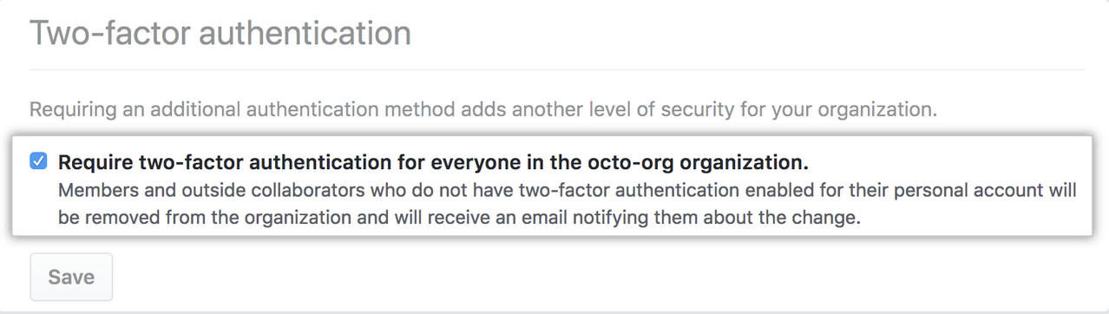
GitHub's added security options
GitHub also offers the following extra security options.
Two-factor authentication
Two-factor authentication (2FA), sometimes known as multifactor authentication (MFA), is an extra layer of security used when logging into websites or apps. With 2FA, users have to sign in with their username and password and provide another form of authentication that only they have access to.
For GitHub, the second form of authentication is a code generated by an application on a user's mobile device or sent as a text message (SMS). After a user enables 2FA, GitHub generates an authentication code anytime someone attempts to sign into their GitHub account. Users can only sign into their account if they know their password and have access to the authentication code on their phone.
Organization owners can require organization members, outside collaborators, and billing managers to enable 2FA for their personal accounts. This action makes it harder for malicious actors to access an organization's repositories and settings.
Enterprise owners can also enforce certain security policies for all organizations owned by an enterprise account.

Slide 13

GitHub's added security options (continued)
GitHub also offers the following extra security options.
SAML SSO
If you centrally manage your users' identities and applications with an IdP, you can configure SAML SSO to protect your organization's resources on GitHub.
This type of authentication gives organization and enterprise owners on GitHub a way to control and secure access to organization resources like repositories, issues, and pull requests. Organization owners can invite GitHub users to join the organization that uses SAML SSO, which allows those users to contribute to the organization and retain their existing identity and contributions on GitHub.
When users access resources within an organization that uses SAML SSO, GitHub will redirect them to the organization's SAML IdP for authentication. After they successfully authenticate with their account on the IdP, the IdP redirects to GitHub to access the organization's resources.
GitHub offers limited support for all identity providers that implement the SAML 2.0 standard with official support for several popular identity providers including:
Active Directory Federation Services (AD FS).
Microsoft Entra ID.
Okta.
OneLogin.
PingOne.

Slide 14
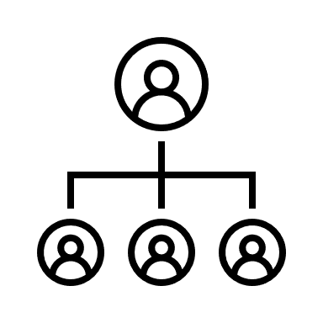
GitHub's added security options (continued)
GitHub also offers the following extra security options.
LDAP
Lightweight directory access protocol (LDAP) is a popular application protocol for accessing and maintaining directory information services. LDAP lets you authenticate GitHub Enterprise Server against your existing accounts and centrally manage repository access. It's one of the most common protocols used to integrate third-party software with large company user directories.
GitHub Enterprise Server integrates with popular LDAP services like:
Active Directory.
Oracle Directory Server Enterprise Edition.
OpenLDAP.
Open Directory.

Slide 15
How does GitHub organization and permissions work?
In the previous unit, you explored the different ways that users can authenticate themselves with GitHub. In this unit, you'll learn about permissions for each hierarchical level:
Repository permissions
Team permissions
Organization permissions
Enterprise permissions

Slide 16

Repository permission levels
You can customize access to a given repository by assigning permissions. There are five repository-level permissions:
Permission Models
Permission Level | Description | Best For
Read | Users can view and clone the repository. Can open and comment on issues and pull requests. | Individuals who need read-only or review access.
Triage | Users can manage issues and pull requests (e.g., label, assign, comment). Cannot push changes to the repository. | Project managers or contributors who need to triage and organize issues without contributing code.
Write | Users can push to branches (except protected branches). Can manage issues and pull requests. | Active contributors who need to commit code or update documentation.
Maintain | Users can manage repository settings, issues, and pull requests. Cannot delete or transfer the repository. | Project maintainers who handle routine repository management but don’t require full admin rights.
Admin | Users have full control over the repository, including setting permissions, deleting the repository, and managing all settings. | Those who need top-level administrative access.
Tip: Always follow the Principle of Least Privilege—assign the lowest permission level necessary for each team to perform its tasks effectively. This approach reduces the risk of accidental or unauthorized changes.

Slide 17
Repository permission levels (continued)
You can give organization members, outside collaborators, and teams different levels of access to repositories owned by an organization. Each permission level progressively increases access to a repository's content and settings. Choose the level that best fits each person or team's role in your project without giving more access to the project than necessary.
After you create a repository with the correct permissions, you can make it a template so that anyone who has access to the repository can generate a new repository that has the same directory structure and files as your default branch.
To make a template:
Step 1
Step 2
Step 3
On GitHub.com, go to the main page of the repository.
Under the repository name, select Settings. If you can't see the Settings tab, open the dropdown menu, and then select Settings.
Select Template repository.

Slide 18


Ways Users Receive Repository Access
Actions of a User Given a List of Their Repository Permissions
A user’s effective permissions in a repository are influenced by various factors, including:
Repository Role:
Team Membership:
Organization Membership:
(e.g., Admin, Write, Read)
(e.g., inherited permissions from a team)
(e.g., default organization permissions, SSO requirements)
When you combine these different permission sources, GitHub applies the highest level of access granted to the user.
For example, if a user has Read access through a team but also has Write access directly assigned as a collaborator, they will effectively have Write permissions.

Slide 19
Repository Membership Options
When granting access to a repository, there are several ways a user can become a collaborator:
Membership Type | Description
Direct Collaborator | Added explicitly to the repository with a specific role (Read, Triage, Write, Maintain, or Admin). Recommended for external contributors or small teams.
Team Membership | A user inherits repository access via their team membership. Team permissions are often set at the organization level for consistent, scalable management.
Organization Default Permissions | If the repository is part of an organization, there may be a default permission level for all organization members (e.g., None, Read). Owners can override these defaults for specific teams or users.
Outside Collaborator | A user who is not a member of the organization but has explicit access to a repository. Useful for contractors, freelancers, or open-source contributors needing limited access.

Slide 20




Monitoring and Auditing Access to a Repository
Regularly auditing who has access to a repository ensures proper security and compliance. Here are some recommended steps and tools:
View Access in Repository Settings:
Organization Audit Log (GitHub Enterprise or Organization-level):
Navigate to Settings > Manage access (for the repository).
Review the list of users and teams, along with their permission levels.
Organization owners can view changes to membership, repository access, and permissions in the Audit log.
Filter events by repository name or access changes for a more focused view.
Enterprise Audit Log (GitHub Enterprise):
Automated Scripting:
If you manage multiple organizations, use the Enterprise account’s audit log to track changes across all organizations and repositories.
This is especially valuable for compliance reporting or large-scale security reviews.
Use the GitHub REST API or GraphQL API to programmatically list collaborators, teams, and permissions.
Integrate scripts with your CI/CD pipeline or security dashboards to continuously monitor and flag anomalies.
Tip: Set up branch protection rules and required reviews to add another layer of security and accountability for all code changes.

Slide 21



Team permission levels
A team in a GitHub organization is a group of users who collaborate on shared repositories. Teams help streamline access management and communication by applying consistent permissions across multiple repositories at once. Key benefits include:
Centralized Access Control:
Structured Collaboration:
Visibility & Communication:
Assign repository permissions (e.g., Read, Write) to the entire team instead of managing each user individually.
Organize members by department, project, or role for more efficient collaboration.
Each team can have its own discussion board, making it easier to share updates and coordinate efforts.
Teams provide an easy way to assign repository permissions to several related users at once. Members of a child team also inherit the permission settings of the parent team, providing an easy way to cascade permissions based on the natural structure of a company.

Slide 22
Two Levels Of Permissions At The Team Level
Understanding the roles within a team is crucial for effective collaboration and access management. Each role comes with specific permissions and responsibilities that help maintain the structure and security of the repositories.
Team Maintainer:
Can add or remove team members.
Can edit the team’s settings (e.g., team name, description).
May manage nested sub-teams (if using team hierarchy).
Cannot modify organization-wide settings unless they also have Owner privileges at the organization level.
Team Member:
Can view and participate in team discussions.
Inherits the team’s assigned repository permissions (e.g., Read, Write).
Cannot manage team membership or settings.
Note: An organization owner can also promote any member of the organization to be a maintainer for a team.

Slide 23
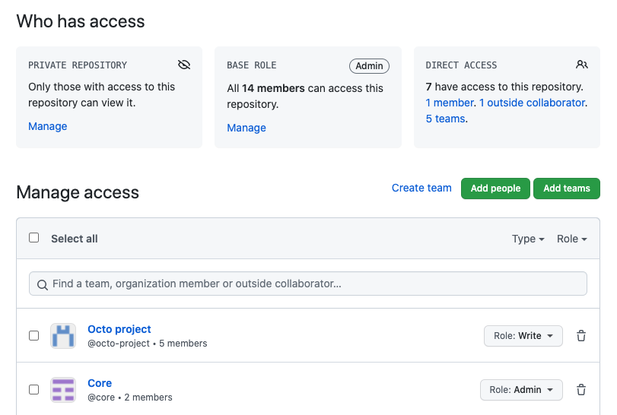
Audit Access To A Repository That You Administer
To audit access to a repository that you administer, you can view a combined list of teams and users with access to your repository in your settings:

Slide 24
Managing enterprise access, permissions, and governance
In the previous unit, you explored how repository and team permissions work in GitHub and how users are granted access at those levels. In this unit, you'll learn how to manage permissions and access at a broader scale across organizations and enterprises:
Organization permissions
Enterprise permissions
Internal vs. external collaborators
Least privilege strategies
Security and governance best practices

Slide 25
Organization permission levels
GitHub organizations provide a centralized way for teams to collaborate on projects while maintaining controlled access to repositories and sensitive data. Organization permissions determine what members and teams can do within the organization, ensuring that each user has the appropriate level of access.
There are multiple levels of permissions at the organizational level:
Permission Level | Description
Owner | Organization owners can do everything that organization members can do, and they can add or remove other users to and from the organization. This role should be limited to no less than two people in your organization.
Member | Organization members can create and manage organization repositories and teams.
Moderator | Organization moderators can block and unblock nonmember contributors, set interaction limits, and hide comments in public repositories that the organization owns.
Billing Manager | Organization billing managers can view and edit billing information.
Security Managers | Organization security managers can manage security alerts and settings across your organization. They can also read permissions for all repositories in the organization.
Outside Collaborator | Outside collaborators, such as a consultant or temporary employee, can access one or more organization repositories. They aren't explicit members of the organization.

Slide 26
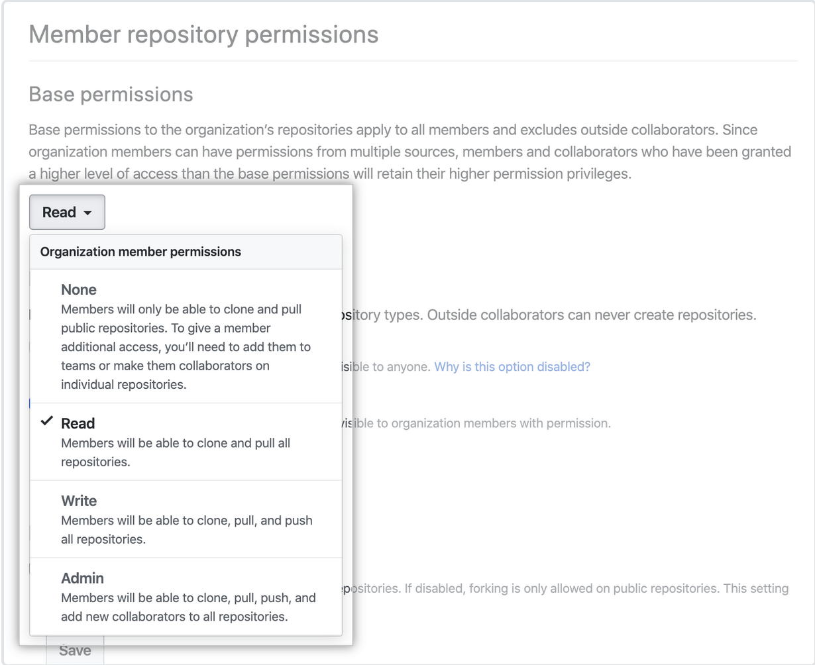
Set Default Permissions For All Members
In addition to these levels, you can also set default permissions for all members of your organization:
For improved management and security, you might also consider giving default read permissions to all members of your organization and adjusting their access to repositories on a case-by-case basis.
If you have a relatively small organization with a low number of users, a low number of repositories, or a combination of the two, this level of restriction might be unnecessary.
If you trust everyone with pushing changes to any repository, you might prefer to give all members write permissions by default.

Slide 27
Enterprise permission levels
Recall from earlier that enterprise accounts are collections of organizations. By extension, each individual user account that is a member of an organization is also a member of the enterprise. You can control various settings related to authentication from this higher level.
There are three levels of permission at the enterprise level:
Permission Level | Description
Owner | Enterprise owners have complete control over the enterprise and can take every action, including: - Managing administrators. - Adding and removing organizations to and from the enterprise. - Managing enterprise settings. - Enforcing policies across organizations. - Managing billing settings.
Member | Enterprise members have the same set of abilities as organization members.
Billing Manager | Enterprise billing managers can only view and edit your enterprise's billing information and add or remove other billing managers.
Guest collaborator | Can be granted access to repositories or organizations, but has limited access by default (Enterprise Managed Users only)

Slide 28
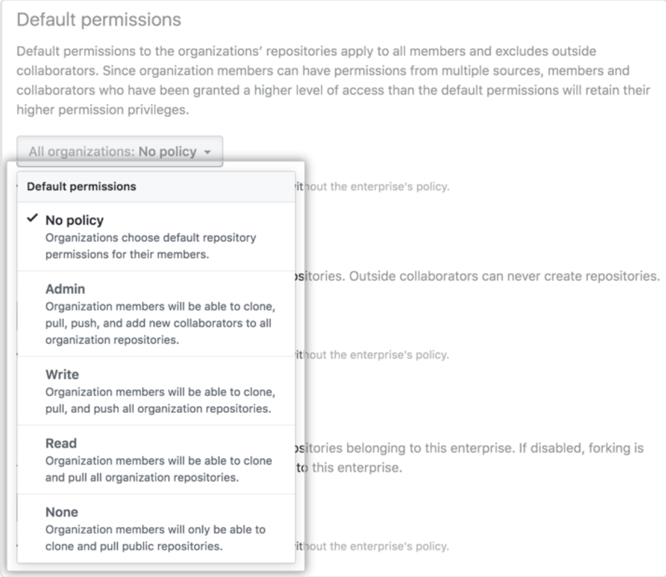
Set A Policy Of Default Repository Permissions
In addition to these three levels, you can also set a policy of default repository permissions across all your organizations:
For improved management and security, you can give default read permissions to all members of your enterprise and adjust their access to repositories on a case-by-case basis. In a smaller enterprise, such as one with a single, relatively small organization, you might prefer to trust all members with write permissions by default.
To further streamline enterprise-scale access control:
Nested Teams: Enterprise accounts can use nested team structures to reflect departmental hierarchies. A parent team’s permissions cascade down to child teams, simplifying complex access management.
Automation & Auditing: You can use GitHub’s API or GitHub Actions to automate team creation and permission assignments, and audit access via organization or enterprise audit logs.

Slide 29
Enterprise Permissions and Policies via Ruleset
This section covers how to manage enterprise permissions and policies through rulesets. We'll explore best practices for structuring organizations, setting default permissions, synchronizing teams via Active Directory (AD), automating multi-org scripting, and aligning policies with your company’s trust and control positions.

Slide 30
Weighing the pros and cons of deploying a single versus multiple organizations
When structuring your enterprise, one of the key decisions is whether to use a single organization or multiple organizations. Each approach has unique benefits and trade-offs.
Single Organization
Multiple Organizations
Pros | Cons
Simplified Management: Centralized control of permissions and policies. | Limited Flexibility: One-size-fits-all policies might not suit all teams.
Consistency: Uniform application of rules and streamlined collaboration. | Security Risks: A single breach could impact the entire organization.
Resource Sharing: Easier asset sharing across teams. | Scalability Issues: Managing permissions can become complex as the organization grows.
Cost Efficiency: Reduced overhead in administrative tooling and licensing.
Pros | Cons
Tailored Policies: Customize permissions to fit the specific needs of each team. | Increased Complexity: More organizations mean more administrative overhead.
Enhanced Isolation: Limits the impact of a security breach to a single organization. | Redundancy: Potential duplication of settings and management efforts.
Decentralized Administration: Teams can manage their own policies and permissions. | Inter-Org Collaboration: May require extra tools or processes for cross-organization projects.
Tailored Policies: Customize permissions to fit the specific needs of each team. | Increased Complexity: More organizations mean more administrative overhead.

Slide 31
Setting default read versus default write across organizations
Deciding on the default permission level is critical to balancing security and collaboration within your enterprise.
Default Read vs Default Write
Default Read | Default Write
Enhanced Security: Minimizes the risk of unintended modifications. | Improved Collaboration: Empowers users to contribute and modify content directly.
Control: Easier to audit and monitor changes. | Efficiency: Reduces bottlenecks in content creation and updates.
Best For: Environments where the majority of users only need to view resources. | Risks: Increases the chance of accidental changes or misconfigurations if not carefully managed.
Enhanced Security: Minimizes the risk of unintended modifications. | Improved Collaboration: Empowers users to contribute and modify content directly.
Recommendation: Use a default read permission model and grant write access selectively, ensuring adherence to the principle of least privilege.

Slide 32
Team synchronization through Active Directory (AD)
Using Active Directory (AD) for team synchronization makes user management and access control easier and more efficient.
Why use AD sync?
Things to consider before implementing
Single source of truth: Keeps user identities consistent across your organization.
Automated access management: Streamlines onboarding, offboarding, and role updates.
Seamless role alignment: Ensures AD groups match enterprise roles and permissions.
Role mapping: Clearly define how AD groups align with your organization's roles.
Sync frequency: Set a schedule that balances performance and security.
Compliance & auditing: Log all changes to meet compliance requirements.
By planning ahead, you can ensure a smooth integration that keeps your organization secure and well-organized.

Slide 33
Maintainability: scripting for multiple organizations and access rights
As your enterprise scales, automating the management of permissions across multiple organizations is essential for maintainability.
Key Practices
Automating the management of permissions across multiple organizations is crucial for maintaining efficiency and security as your enterprise grows. This section provides key practices for scripting and automation to ensure consistent and scalable permission management. By following these practices, you can streamline administrative tasks, reduce manual errors, and maintain a secure and well-organized environment.
Modularity: Develop scripts in modular components to handle different organizations with minimal changes.
Reusability: Create reusable functions or modules to perform common permission tasks.
Testing: Thoroughly test scripts in a controlled environment before deployment.
Logging: Implement detailed logging to track changes and facilitate troubleshooting.
Version Control: Use version control systems (like Git) to manage script revisions and collaborate with team members.

Slide 34
Knowledge Check:
1 of 6
What is a benefit of integrating Active Directory (AD) for team synchronization?
A) Centralized Identity Management
B) Increased administrative overhead
C) Decentralized administration D) Enhanced isolation
© Copyright Microsoft Corporation. All rights reserved.

Slide 35
Knowledge Check:
2 of 6
Which of the following actions can Organization Members perform? (Select all that apply)
A) Collaborate on repositories based on assigned roles or team memberships.
B) Contribute code and participate in discussions.
C) Manage organization settings, including security and billing.
D) Access resources as defined by team or repository-specific permissions.
© Copyright Microsoft Corporation. All rights reserved.

Slide 36
Knowledge Check:
3 of 6
What is a key difference between an organization member and an outside collaborator?
A) Organization members are included in the organization’s internal directory.
B) Outside collaborators have access to all repositories.
C) Organization members do not appear in the organization’s internal member list.
D) Outside collaborators inherit organization-wide settings.
© Copyright Microsoft Corporation. All rights reserved.

Slide 37
Knowledge Check:
4 of 6
Which permission level allows users to manage repository settings but not delete or transfer the repository?
A) Maintain
B) Write
C) Admin
D) Triage
© Copyright Microsoft Corporation. All rights reserved.

Slide 38
Knowledge Check: Enterprise Teams Permissions
5 of 6
Which role within a team can add or remove team members?
A) Team Maintainer
B) Team Member
C) Organization Owner D) Billing Manager
© Copyright Microsoft Corporation. All rights reserved.

Slide 39
Knowledge Check: Enterprise Teams Permissions
6 of 6
What permission level is best for project managers who need to triage and organize issues without contributing code?
A) Triage
B) Read
C) Write D) Maintain
© Copyright Microsoft Corporation. All rights reserved.

Slide 40
Summary
In this module, you built a clear mental model of the GitHub administrator’s role—how to protect code and content while empowering teams to collaborate effectively. You saw how administrators can choose and enforce authentication methods, from personal tokens and SSH keys to SAML SSO and LDAP, and mandate two-factor authentication for added security. You learned to design cascading permissions at the team, organization, and enterprise levels, mapping real-world structures onto GitHub’s hierarchy.
Learn more
Here are some links to more information on the topics we discussed in this module.
Managing teams and people with access to your repository
Assigning the team maintainer role to a team member
Roles in an organization
Setting base permissions for an organization
Roles in an enterprise
Enforcing repository management policies in your enterprise
Organizations
Managing team synchronization for your organization
Managing your personal access tokens
Generating a new SSH key and adding it to the ssh-agent
Deploy keys
Requiring two-factor authentication in your organization
Enforcing policies for security settings in your enterprise
About identity and access management with SAML single sign-on
Using LDAP
Repository roles for an organization

